Slide 1

Brain-Droid final presentation
Fahad Alqattan, Vanessa Plugues, Camilo Moreno

Slide 2
About the App
‘Brain-Droid’ is an educational mobile app. Built in 2015 by senior students from Florida Atlantic University. Brain-Droid was developed to increase math skills through math testing, vocabulary through vocabulary testing, and improve retention ability and productivity through memory testing.

Slide 3
How it relates to learning
This app will help the user develop educationally in 3 areas
Mathematics
Challenges the user’s knowledge of basic mathematic operations
Memory retention
Improves the user’s memory retention after only 5 minutes of playing
Vocabulary
Enhances the vocabulary of the user, while giving hints if needed.

Slide 4
How the app works
First introduced to our individual logos
Log-In page appears where you can Log-in, Register or View the About Page
Have the option to select 3 games and the option to View Account Page or View progress report.
Select a game, and you will be able to play the game. Self-Explanatory Instructions.
Account page allows the user to change username, password, and send the professor a message
Progress report displays your highest score and the ratio of your abilities.

Slide 5
Math Game

Slide 6
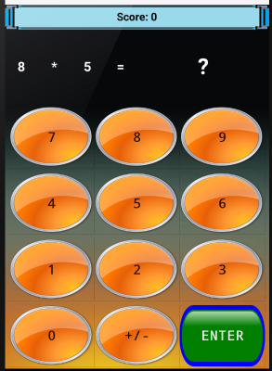
About Math Game
A question will appear, and you will have to use the buttons to enter the answer.
Correct Answer you get 1 point.
Wrong Answer you do not lose any points.
Continue until you want to quit .
Score will appear on the top as a TextView

Slide 7
Memory Game

Slide 8
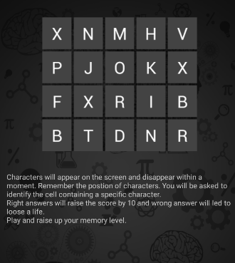
About Memory Game
Characters will appear on the screen and disappear within a moment. Remember the position of characters. You will be asked to identify the cell containing a specific character. Right answers will raise the score by 10 and wrong answer will led to loose a life. Play and raise up your memory level.

Slide 9
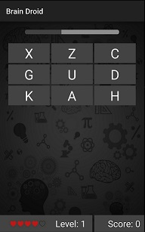
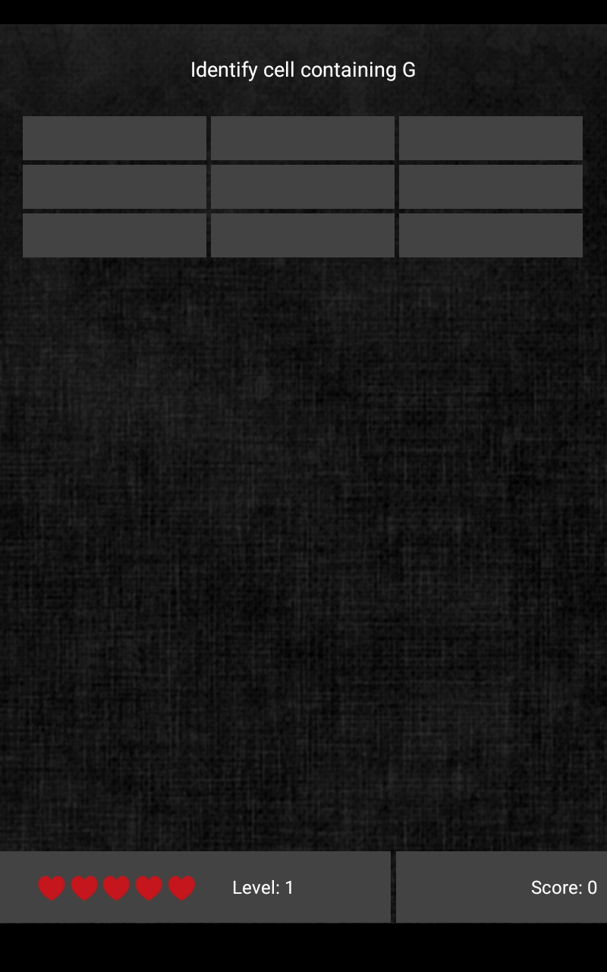
Starting the game
Progress Bar act as Timer
Expandable Grid View (game Layout)
Score
Level
Life Points

Slide 10
Vocab Game

Slide 11
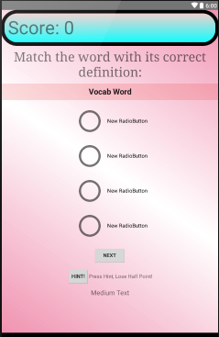
About vocab Game
Challenges your vocabulary.
If you know the definition, you get one point.
If you get the answer wrong, you lose one point.
If you press a hint, you lose half a point.
Score will appear in the top as a text view.

Slide 12
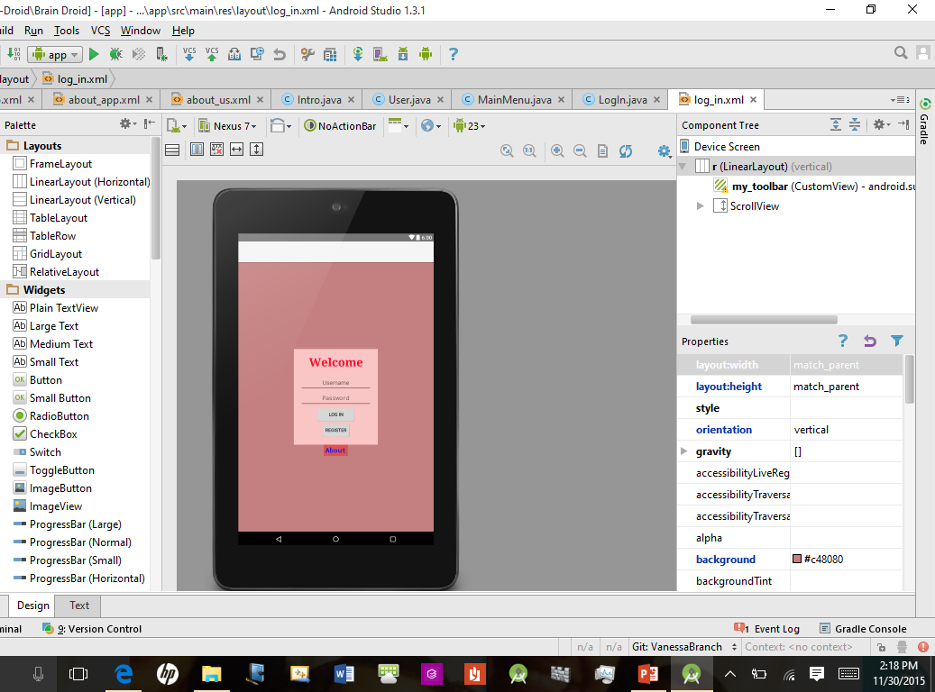
App demo

Slide 13
ideas not reached and future ideas
INCOMPLETED:
Memory Game: Could not use digital font for the timer so I used the progress bar instead
Memory Game: I had hard time to add a pause function for the game
FUTURE:
Make an individual app for the professor
Develop games more. Make them more complex and more engaging. Make more knowingly educational.
Examples: adding pause buttons for all games, and allow the game to pause when the user exits the app, maybe add a timer, add more levels, and increase difficulty .

